Slide 1

ACNOLOGIA :
STOCK PRICES PREDICTOR
Aniruddha Prasad (R16BS011)
Jayant Bishnoi (R16BS034)

Slide 2
Agenda :
Abstract
Introduction
Existing Methods
Proposed System
Implementation
Results
Conclusion

Slide 3
Abstract
Time series forecasting has been widely used to determine the future prices of stock, and the analysis and modelling of finance time series importantly guide investors’ decisions and trades
This work proposes an intelligent time series prediction system that uses sliding-window optimization for the purpose of predicting the stock prices
Thus, by using 4 different algorithms mixture, we are rendering the machine learning model with given provided historical stock price dataset of AAPL – stock, we are able to predict the future stock price for the same company. Which can be seen on insights which are plotted by mat plot lib.

Slide 4
Introduction
Financial markets are highly volatile and generate huge amounts of data daily
It is the most popular financial market instrument and its value changes quickly
Stock prices are predicted to determine the future value of companies’ stock or other financial instruments that are marketed on financial exchanges
However, the stock market is influenced by many factors such as political events, economic conditions and traders’ expectation

Slide 5
Existing Methods:
Existing methods include Knowledge discovery in data (KDD)
Firefly Algorithm
And few other statistics methods :
LSTM (Long Term Short Memory)
But existing systems had few disadvantages :
The system doesn’t allows import of raw data
The existing system cannot be used to analyze multi-variate time series

Slide 6
Proposed System
Here we have came up with solution :
To generalize the application of the existing system, our work uses the system to estimate other stocks in similar emerging markets and mature markets
The system can be extended to analyze multivariate time series data and import raw dataset directly
Profit can be maximized even when the corporate stock market is has lower value
We are creating two solution notebook i.e.,
Stock prediction for a day
Stock prediction for a tenure

Slide 7
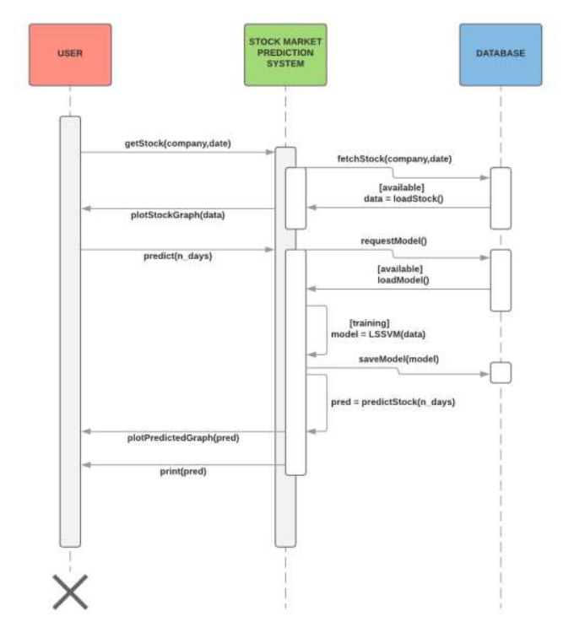
Implementation

Slide 8
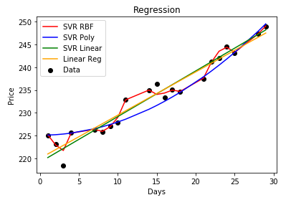
Results

Slide 9
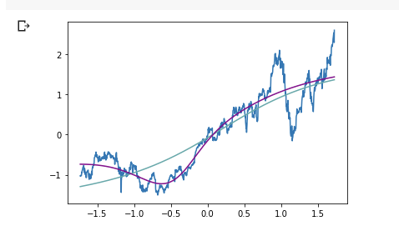
NEURAL NETWORK OUTPUT :

Slide 10
THANK YOU :)

Slide 11
Conclusion
This project was done with an aim to predict the future stock price(s) of any given company (here we have used Apple Inc. stock data). Even though our implementation focused on two different scenarios i.e., scenario 1 as predicting the stock price for a company on any given future date & scenario 2 as predicting the stock price for a company for a given tenure with optimal accuracy in it. Since Data Science is a huge domain of intercorrelated fields likestocks, housing, medicine prices and other financial dataset based analysis. Allused algorithms in our project like Support Vector Machine(s), LinearRegression and even Neural Networks can be moulded and be implemented on other kind of datasets on accordance to the Data Scientist requirements.

